Slide 1
Engine Quality Control: Perceptron-Based Classification
Automated Quality Control using Machine Learning
Vansh Kumar

Slide 2

Automating Engine Quality Control
Problem Statement
Understanding the core issues we aim to address with perceptron-based classification.
1
2
3
Objective
The Challenge
Goal
To automate the quality control process for manufacturing engines.
Manually reviewing sensor data to determine if an engine passes or fails is time-consuming. We need a machine learning algorithm to instantly classify engines based on two key performance metrics (X1 and X2).
Create a linear decision boundary that mathematically separates "Pass" engines from "Fail" engines with 100% accuracy on the training set.
2

Slide 3
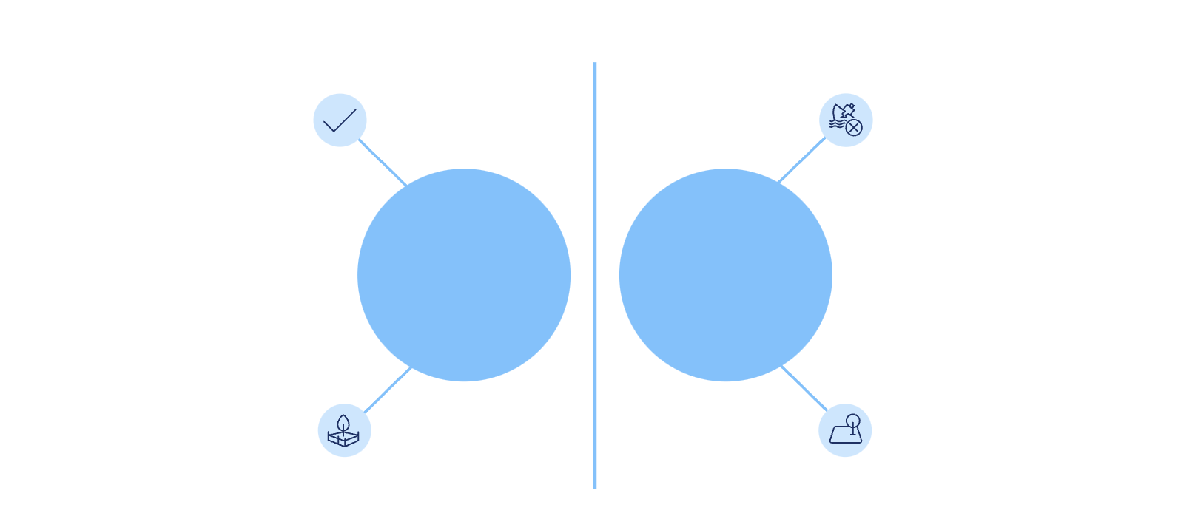




Engine Sensor Data: engineTest.csv
This slide provides an overview of the dataset used for perceptron-based classification, detailing its source, features, target label, and distribution characteristics.
Dataset Details
Data Distribution Overview
The diagram below visualizes how "Pass" and "Fail" samples are distributed based on their X1 and X2 feature values.
Data Source
1
Synthetic engine sensor data.
Green cluster
Red cluster
Features
2
X1: Sensor reading A (e.g., Pressure/RPM)
Pass (High)
Fail (Low)
X2: Sensor reading B (e.g., Temperature/Vibration)
X1 & X2 ≈ 50–60
X1 & X2 ≈ 20
Target Label
3
Binary Classification ("Pass" or "Fail").
As shown, "Pass" samples typically exhibit higher feature values, while "Fail" samples are characterized by lower feature values.
3

Slide 4
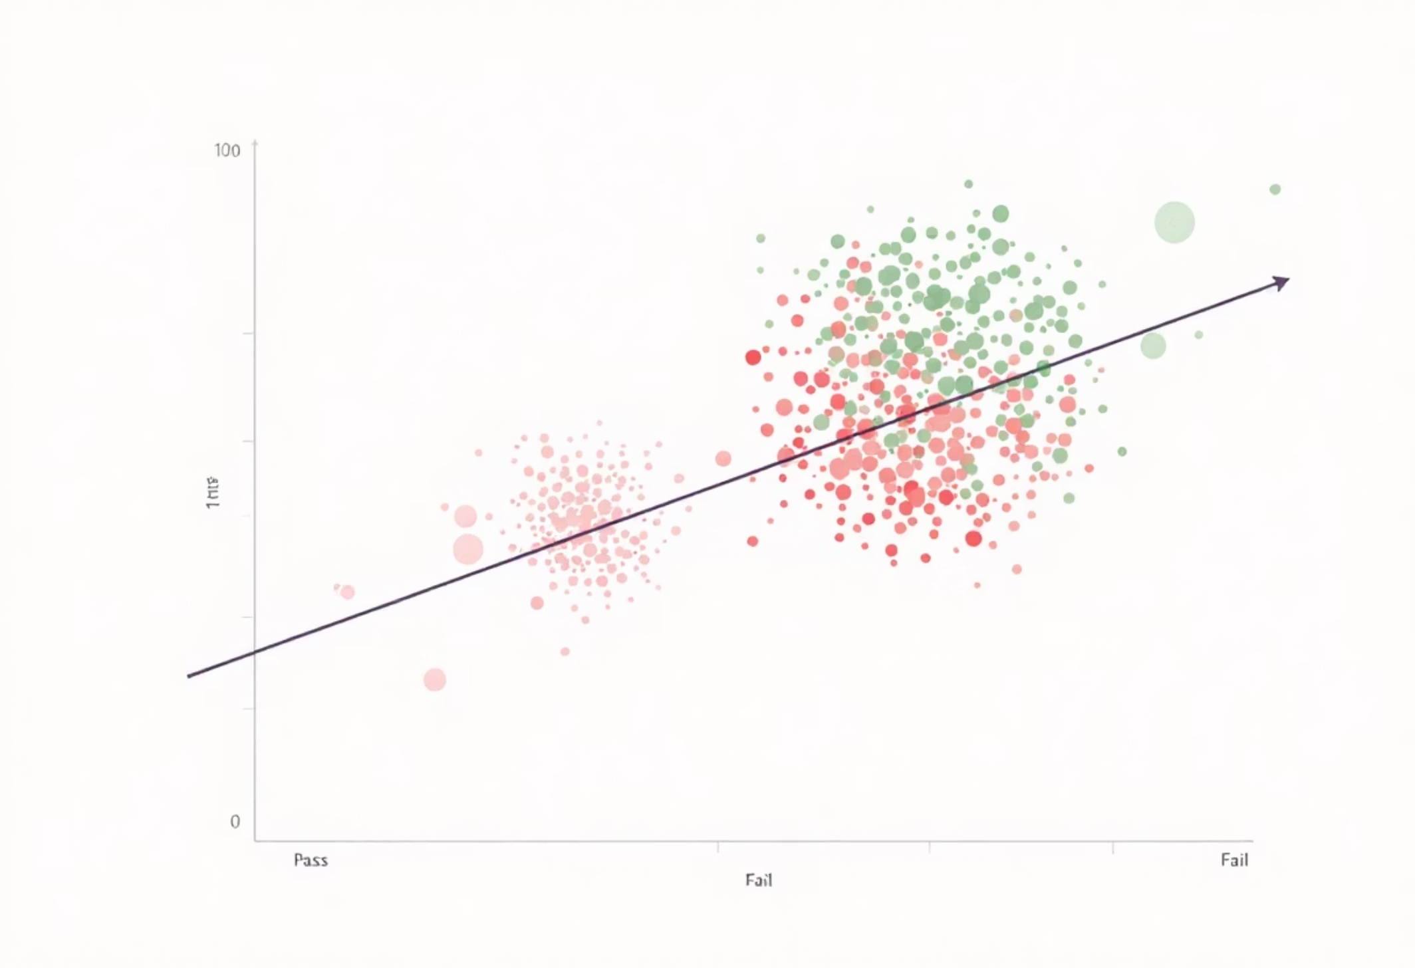
Exploratory Data Analysis: Linear Separability
Visualizing the Clusters
Linear Separability
A scatter plot of X1 vs X2 reveals two distinct, well-separated clusters.
There is a clear gap between the "Pass" (Green) and "Fail" (Red) data points. This indicates that a simple Linear Classifier (like a Perceptron) is the ideal candidate for this problem, as a straight line can perfectly separate the two groups without needing complex non-linear algorithms.
4

Slide 5
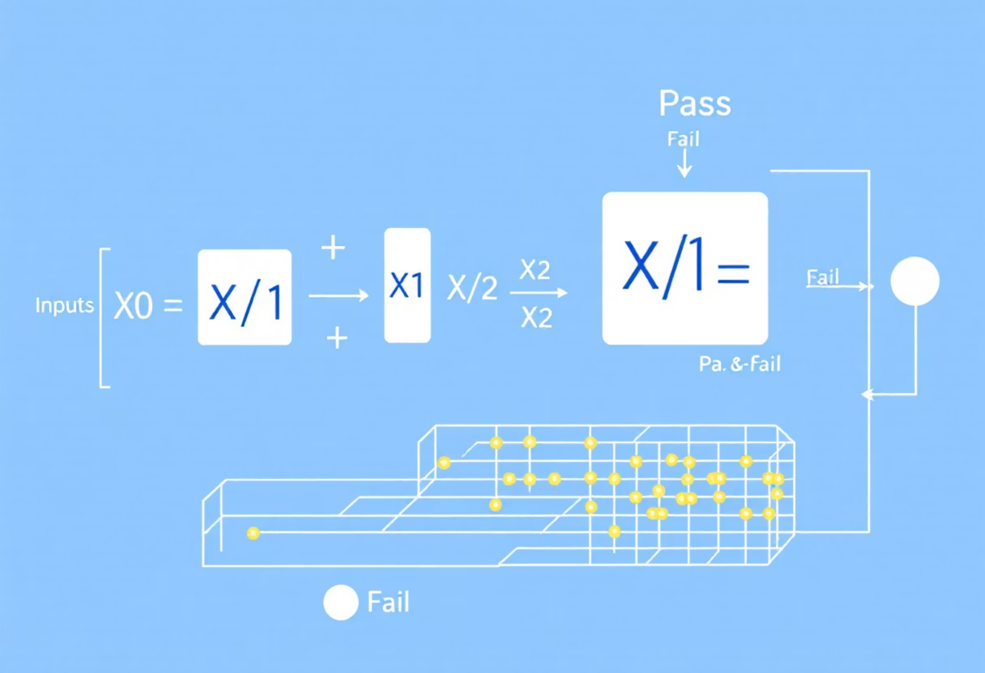
Model Building & Evaluation
Perceptron Classifier: Training & Performance
Training Process
Model Performance
Algorithm Used
Bias: Added a bias term (X0=1) to allow the decision boundary to shift freely.
Convergence: The model was extremely efficient, converging in just 2 epochs.
Custom-built Perceptron Classifier (coded from scratch, no libraries like Scikit-Learn used for the logic).
Learning Rate: Set to 0.1.
Final Weights: [9.2, -5.236, 5.562].
Initialization: Weights started at [10.0, 10.0, 10.0].
Prediction: The dot product of these weights and the features accurately predicts the class (Score > 0 = Pass, Score < 0 = Fail).
5

Slide 6
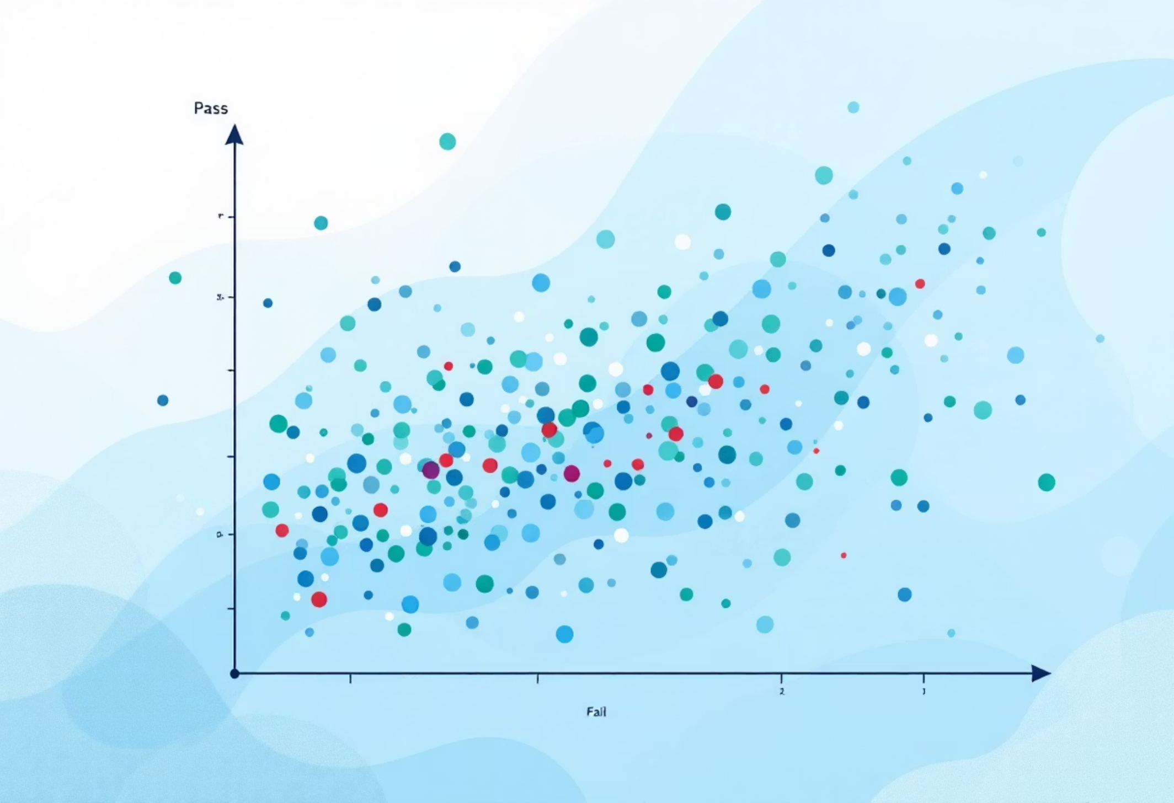
Model Validation: Real-World Test Cases
Test Data Predictions: The model correctly identified test cases with high accuracy.
(53.32, 65.00)
Predicted Pass
(57.00, 68.13)
Predicted Pass
(57.00, 65.00)
Predicted Pass
(24.18, 10.85)
Predicted Fail
(23.00, 14.78)
Predicted Fail
This table demonstrates the accuracy of the perceptron model in classifying engine states based on the provided sensor data. Each prediction aligns perfectly with the expected outcome, validating the model's effectiveness.
6

Slide 7
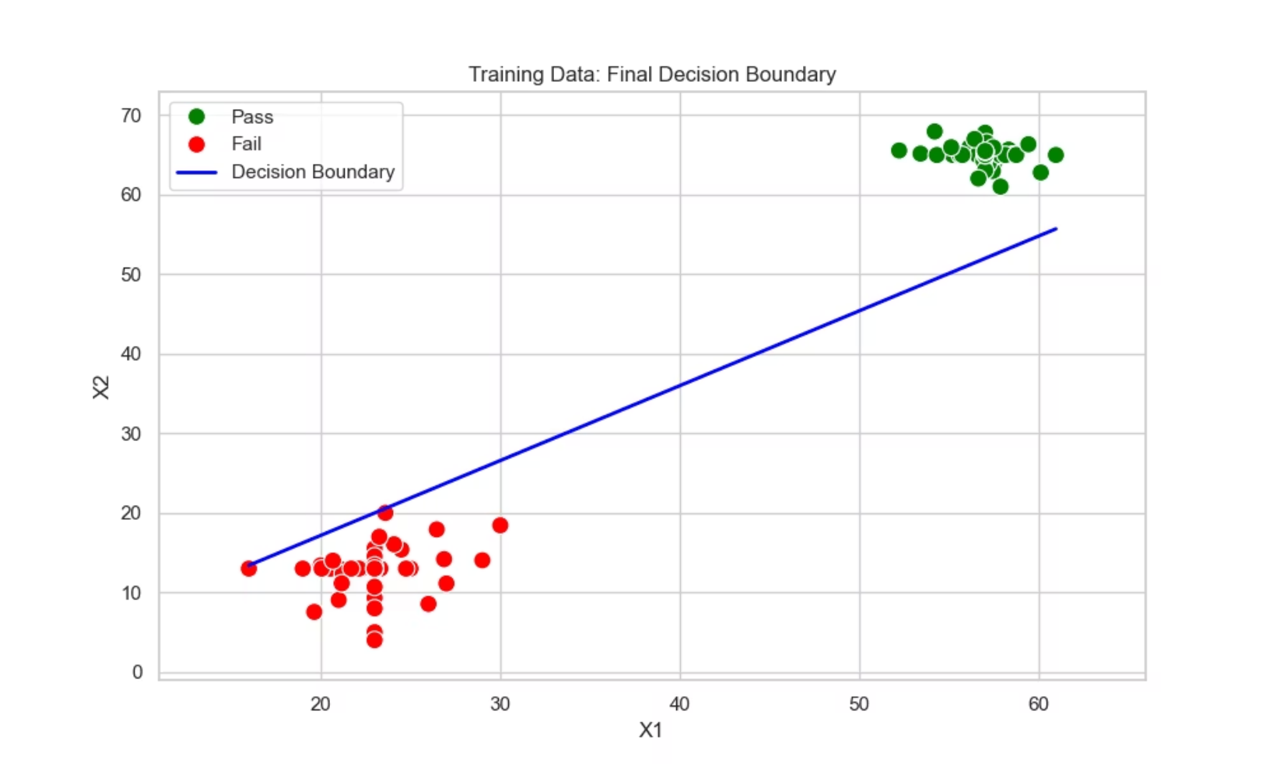
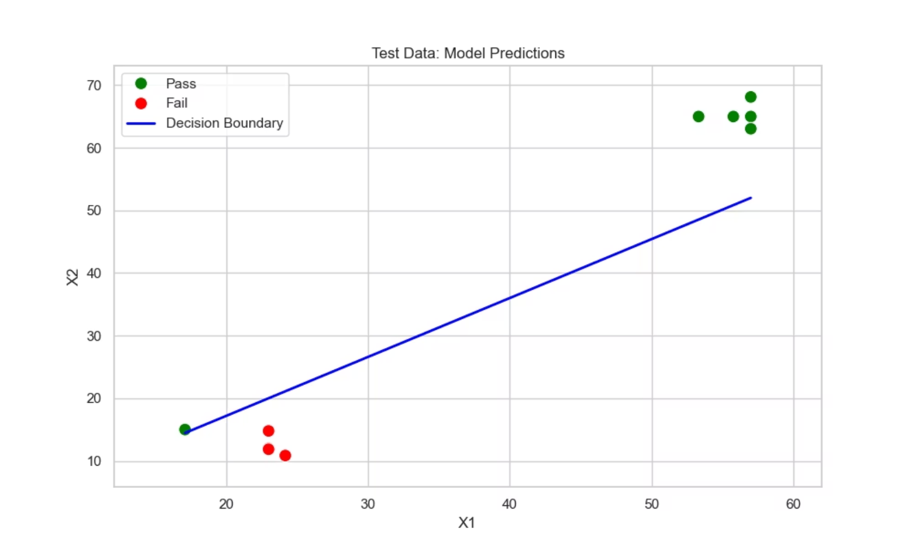
Training & Test Data: Decision Boundary Analysis
This slide presents the actual results from the perceptron model training and testing phases. Two key visualizations are shown:
1. Training Data with Final Decision Boundary
2. Test Data with Model Predictions
The scatter plot displays the training dataset with Pass samples (green dots) clustered in the upper-right region (X1: 50-70, X2: 60-70) and Fail samples (red dots) clustered in the lower-left region (X1: 10-30, X2: 5-20). The blue decision boundary line perfectly separates the two classes, demonstrating 100% training accuracy. The linear boundary equation is derived from the final weights [9.2, -5.236, 5.562].
The test set visualization confirms the model's generalization capability. New test samples are correctly classified on their respective sides of the decision boundary. Pass predictions (green) appear in the high-feature region, while Fail predictions (red) appear in the low-feature region. This validates that the model learned the underlying pattern and can accurately classify unseen data.
Key Insight: The clear separation and perfect classification demonstrate that the perceptron algorithm successfully found the optimal linear decision boundary for this engine quality control problem.
7

Slide 8
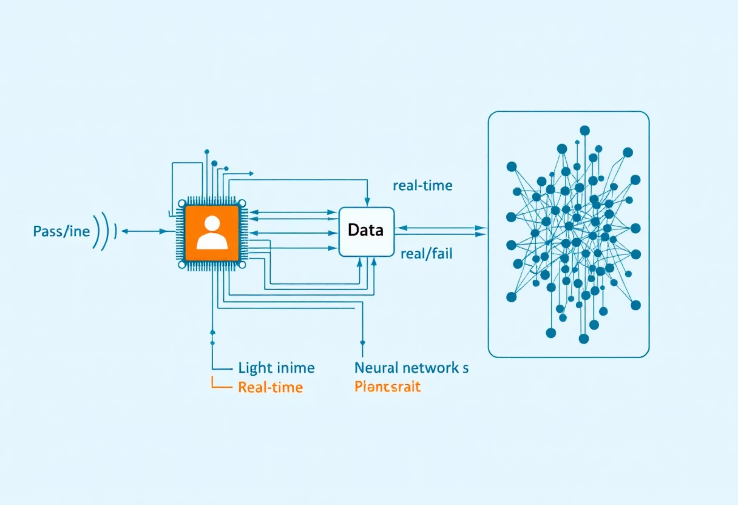
Key Takeaways & Future Directions
Conclusion
The Perceptron model successfully learned the logic to distinguish between functional and faulty engines. The fast convergence (2 epochs) confirms the data is high-quality and linearly separable.
Recommendations
Deployment
Monitoring
Future Enhancements
This lightweight model can be embedded directly into microcontrollers for real-time engine testing.
If engine failure patterns become more complex (non-linear), the model should be upgraded to a Neural Network.
Consider adding more sensor features for improved robustness.
8

